Slide 1
CIS 9650 FALL 2022 Group Project
Group: 8
Yuhang Lin, Harrison Choy, Yongneng He, Peiwen He, Yu Luo, Qinglan Chen

Slide 2
Data: Json API to DataFrame
NYPD Shooting Incident Data (Historic) (Rows: 25.6K; Columns: 19; Each row is a Shooting Incident)
https://data.cityofnewyork.us/Public-Safety/NYPD-Shooting-Incident-Data-Historic-/833y-fsy8
NYPD Arrests Data (Historic) (Rows: 5.31M; Columns: 19; Each row is a Arrest in NYC by NYPD)
https://data.cityofnewyork.us/Public-Safety/NYPD-Arrests-Data-Historic-/8h9b-rp9u
NYPD Complaint Data Historic (Rows: 7.83M; Columns:35; Each row is a Complaint)
https://data.cityofnewyork.us/Public-Safety/NYPD-Complaint-Data-Historic/qgea-i56i
Function that convert json to dataframe with limit input:
def json2dataframe(url="", limit=""):
"""Take url and limit and format it to return to the data and dataframe"""
url = url
resp = requests.get(f"{url}?$limit={limit}")
resp.raise_for_status()
return pd.DataFrame(resp.json())

Slide 3
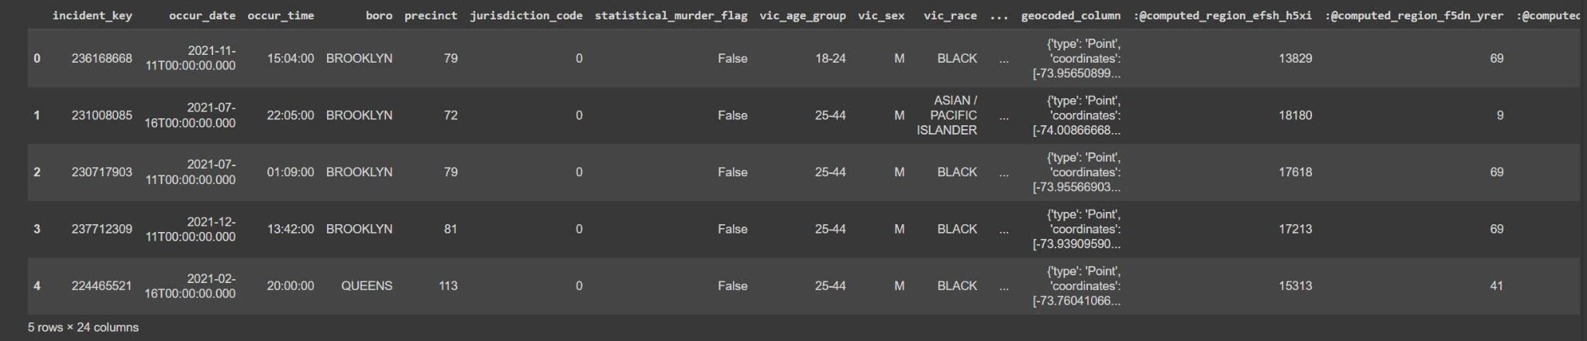
Data Cleaning
Original DataFrame, needs cleaning for our use:
Columns we find useful:
'Incident_key','occur_date','occur_time','jurisdiction_code','vic_age_group','vic_sex','perp_age_group','perp_sex','boro','statistical_murder_flag', 'latitude','longitude'

Slide 4
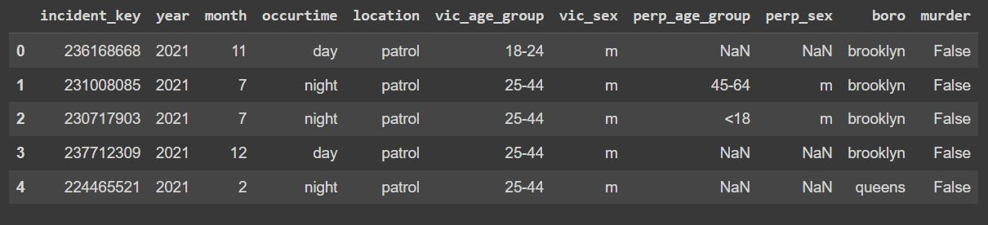
Data Cleaning
After several steps as:
Convert date to year and month and into integer;
Convert time into day and night based on (day as 6:00~17:59, else as night)
Convert jurisdiction code into (0 as patrol, 1 as transit, 2 as housing)
Lower case 'boro', 'vic_sex', 'perp_sex'.
Rename some columns
DataFrame for our study

Slide 5
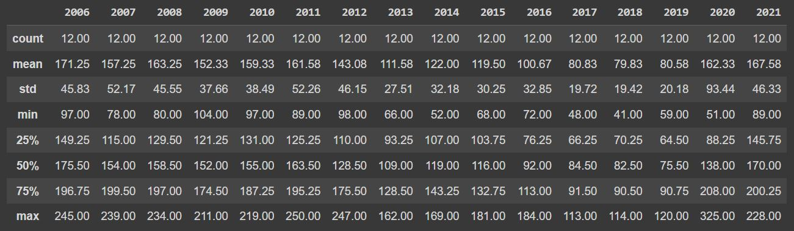
Statistical Analysis
def getsummary(x, y):
"""get summary for each value of x based on count grouped by y"""
list1 = sorted(mydf[x].unique())
output = pd.DataFrame()
for value in list1:
output[value] = mydf[mydf[x]==value].groupby(y)['incident_key'].count().describe().apply('{:.2f}'.format)
return output
Example: Summary of total incident by month for each year in the data(getsummary('year', 'month'))

Slide 6
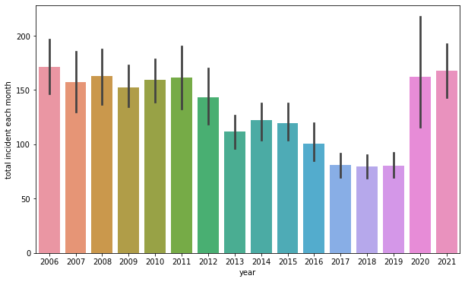
Visualization
We find that from 2006 to 2019 the total shooting each year is decreasing. We see that 2020 and 2021 have bounced back to where we were in 2006. One of the possible reason might be the consequence of covid 19 pandemic. Also we find the variance is the most in year 2020.

Slide 7
Now we plot the total by month from certain time period.
Create a new dataframe here
yearmonthdata = (mydf.groupby(["year","month"])["incident_key"]
.agg([('total_incident','count')])
.reset_index())
Define function for plot:
def plotbymonth(width, height, yearlist):
"""plot width and height and different year"""
w = width
h = height
yl = yearlist
plt.figure(figsize=(w, h))
totalyl = yearmonthdata[yearmonthdata['year'].isin(yl)].pivot_table('total_incident',index='month',columns='year')
totalyl.plot(figsize =(w,h), title=f'Total shooting incident from {min(yl)} to {max(yl)}')
For loop to plot:
list1 = [2006,2007,2008,2009]
for i in range(0,4):
plotbymonth(6,4,list1)
list1 = [x + 4 for x in list1]

Slide 8
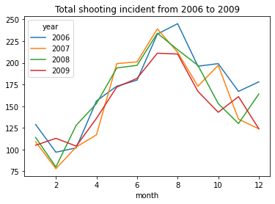
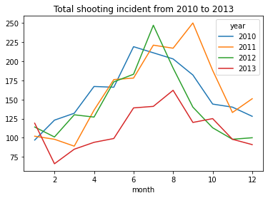
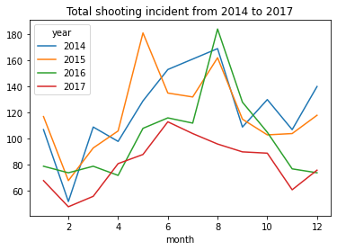
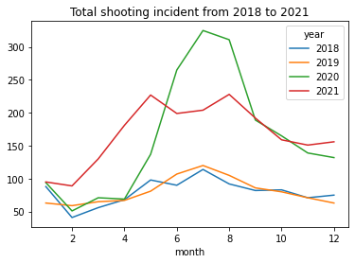

Slide 9
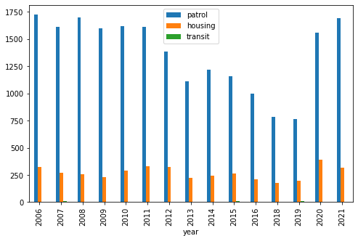
One interesting finding was that the shooting incidents tend to increase during the summer time, which might be because people tend to go outside since it is nice and warm for summary compare to winter. It is supported by the fact that the shooting location tends to be outside.

Slide 10
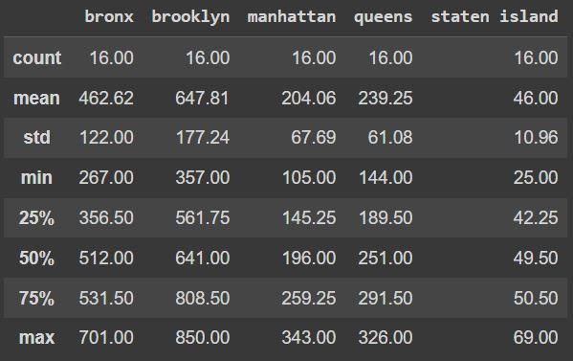
Summary of total incident by year for each boro in the data(getsummary('boro', 'year'))

Slide 11
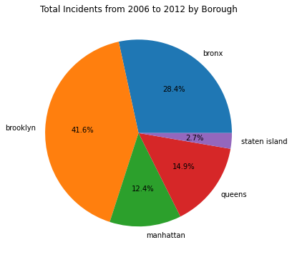
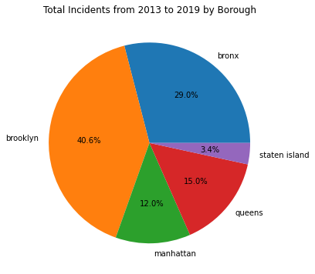
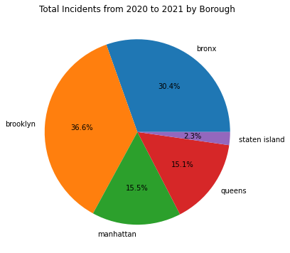
Visualization
The percentage of total incident tends
to stay constant over time.

Slide 12
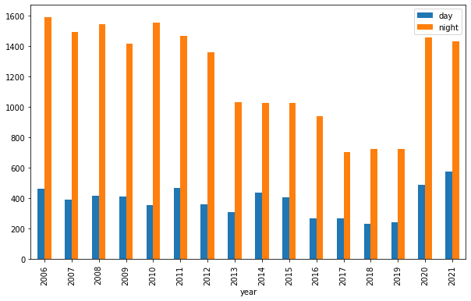
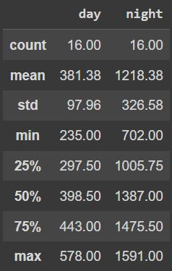
As expected, shooting tends to occur at night.

Slide 13
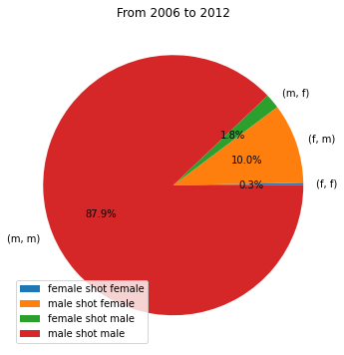
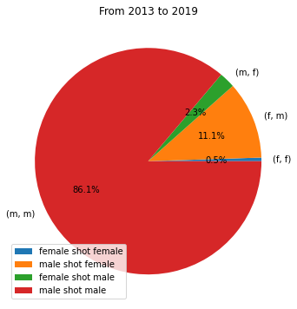
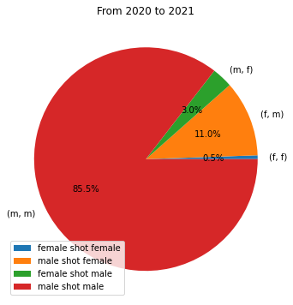
Visualization
Most of shooters were male and percentage stays constant over time.

Slide 14
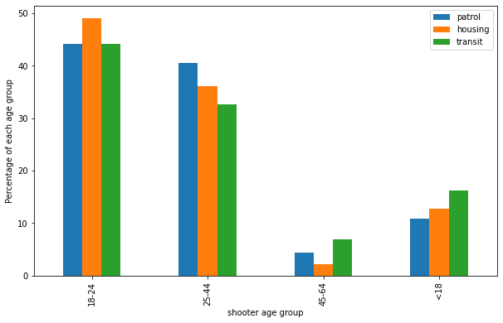
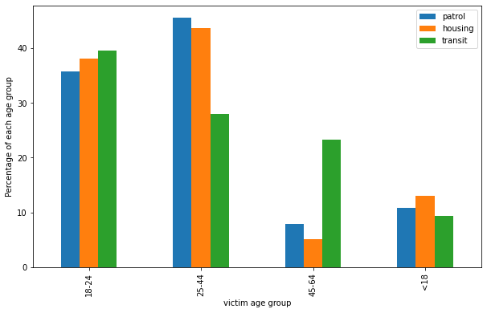
Visualization
Here we show the percentage for each age group for different location, both shooter and victim data shown here.

Slide 15
Code for mapping each incident location by latitude and longitude
Function that mapping dataframe b by year a:
def mappingbyyear(a,b):
year = a
mydfformap = b
mydfformap = mydfformap[mydfformap['year']==year]
latitude = np.float_(mydfformap.latitude.values.tolist())
longitude = np.float_(mydfformap.longitude.values.tolist())
map_box = [-74.4331, -73.5267, 40.4673, 40.9270]
map_img = plt.imread('map.png')
fig, ax = plt.subplots()
ax.scatter(longitude, latitude)
ax.set_ylim(map_box[2], map_box[3])
ax.set_xlim(map_box[0], map_box[1])
ax.imshow(map_img, extent=map_box, alpha=0.9)
plt.title(f'Year: {year}')
plt.rc('figure',figsize=(15,15))
plt.savefig("mad_mod.png")
plt.show()

Slide 16
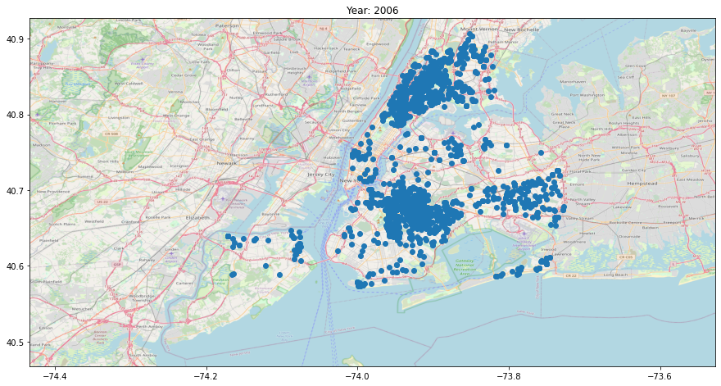
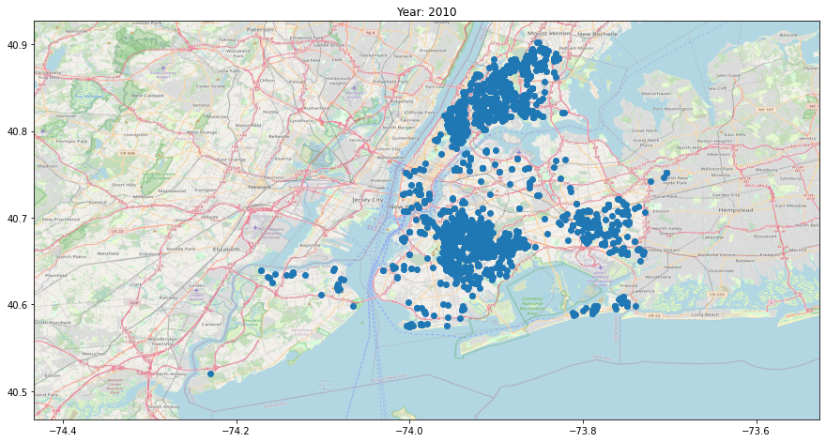
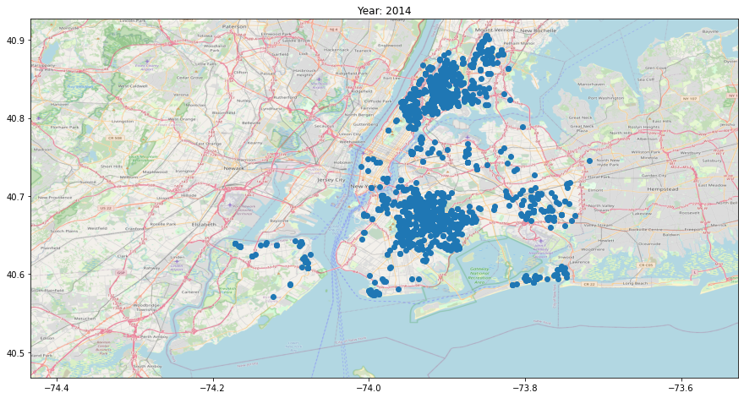

Slide 17
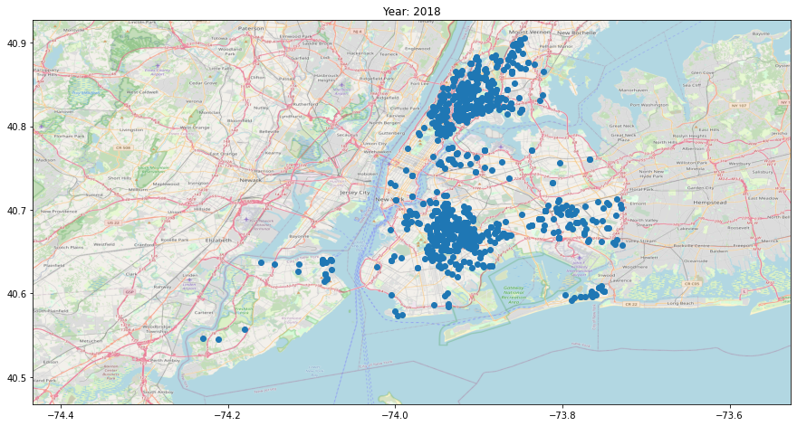
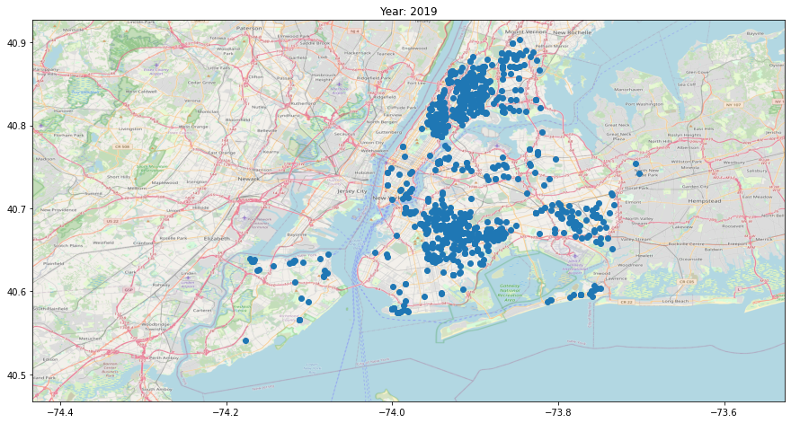
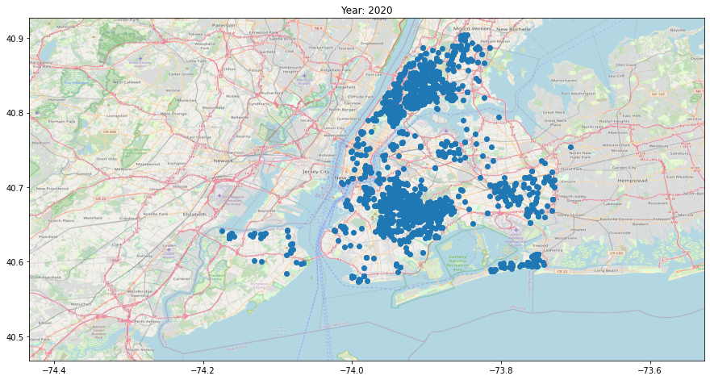
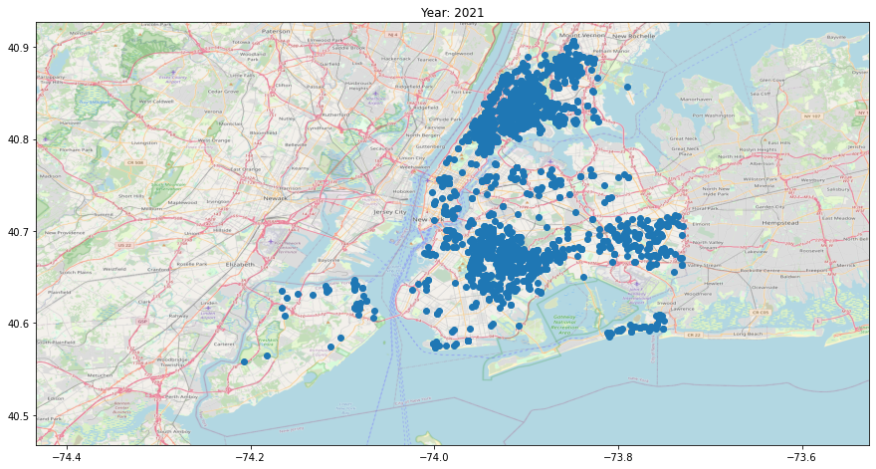

Slide 18
Linear Regression of Y(total incident) against X1(total complaint) and X2(total arrest)
We are trying to study the shooting history data(Y) with complaint history data(X1) and arrest history data(X1) to see if there is a relation between Y~X1+X2. We filter out the year of 2016 and 2017 for all three data sets due to data processing limitation(5 Million rows). After that, we group the datas based on latitude and longitude and count the total cases for each [latitude, longitude]. Then we merge three dataframes into one dataframe based on latitude and longitude.
Next we do a scatter plot of Y against X1 and X2.

Slide 19
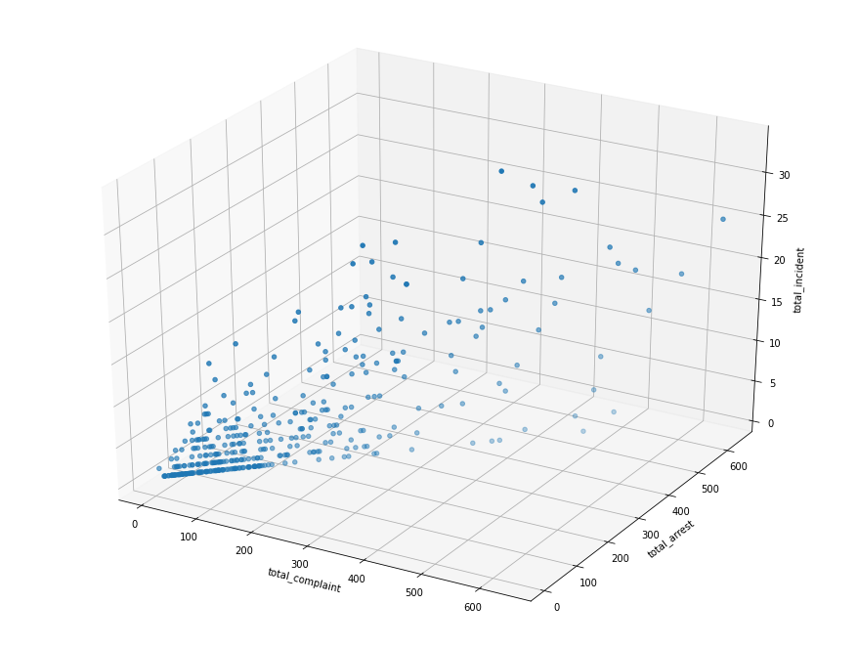
3D Scatter plot
We see there is relation of between Y and X1, X2.

Slide 20
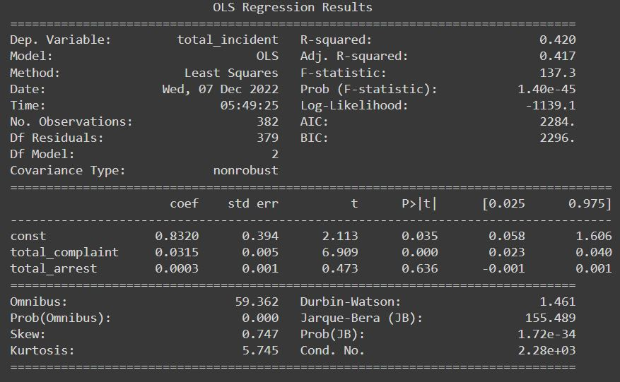
Linear Regression
Regression function: (Y hat: Estimate Total incident) = 0.8320 + 0.0315(X1: Total complaint) + 0.0003(X2: Total arrest)
All the coefficients being positive indicate the positive relation of Y against X1 and X2.
R-squared as 0.420 not bad for exploratory observational data.
We notice that the P-value for X2(Total arrest) is more than 0.05 indicating X2 can be dropped from this model.
Further study is needed as other omitted variables and model assumption validation.

Slide 21
Code for mapping total cases by zip for 2017
Pretty cool function that can transfer lat and lon to zipcode
def get_zipcode(df, geolocator, lat_field, lon_field):
try:
location = geolocator.reverse((df[lat_field], df[lon_field]))
return location.raw['address']['postcode']
except (AttributeError, KeyError, ValueError):
return None
geolocator = geopy.Nominatim(user_agent='andrewluoyu')
def getziplot(title,output,df):
fig, ax = plt.subplots(figsize=(15,10))
ax = df.plot(column = 'total',
cmap='Blues', ax=ax,
legend=True,
legend_kwds={'shrink': 0.7})
cb_ax = fig.axes[1]
cb_ax.tick_params(labelsize=10,
direction='out',
length=5,
width=1,
grid_alpha=1)
ax.set_title(title, fontdict={'fontsize': 20}, loc='center')
ax.set_axis_off()
plt.savefig(output,format = 'png',bbox_inches='tight')
getziplot("NYC Total shooting incident year 2017 by Zipccode",'shooting2017zip.png',df_merge_df1)
getziplot("NYC Total complaint year 2017 by Zipccode",'complain2017zip.png',df_merge_df2)
getziplot("NYC Total arrest year 2017 by Zipccode",'arrest2017zip.png',df_merge_df3)

Slide 22
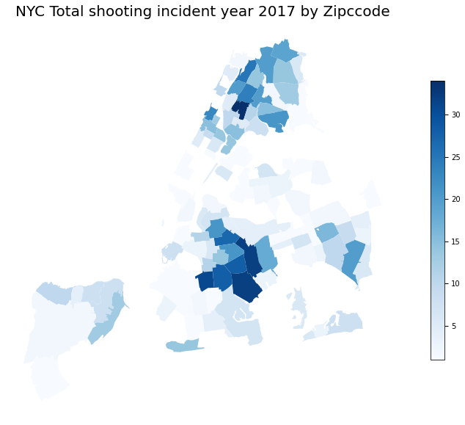

Slide 23
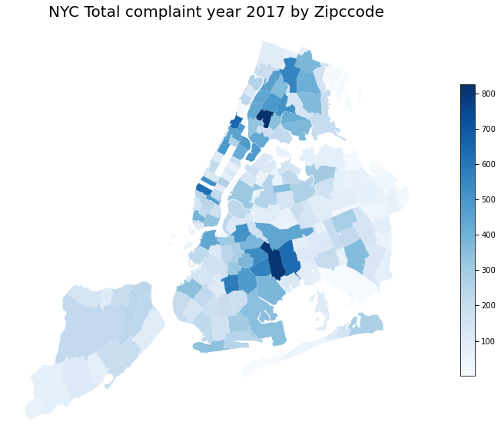
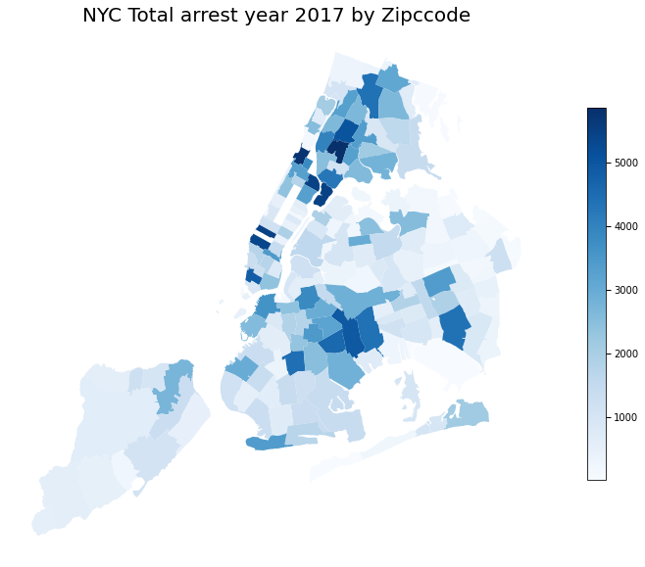

Slide 24
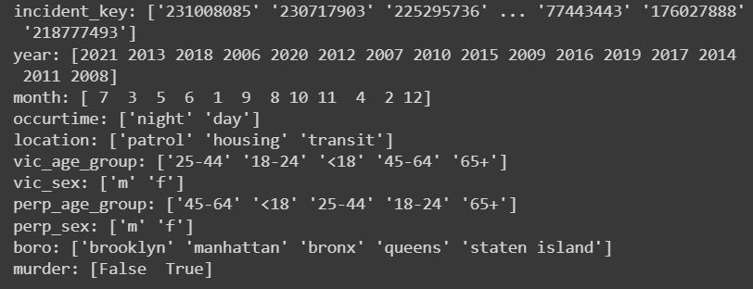
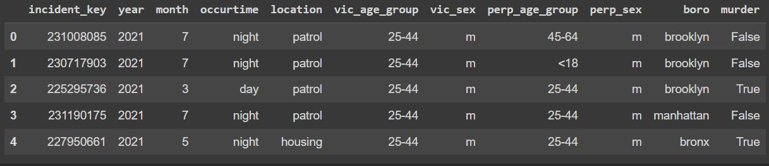
Cleaned Data To Database

Slide 25
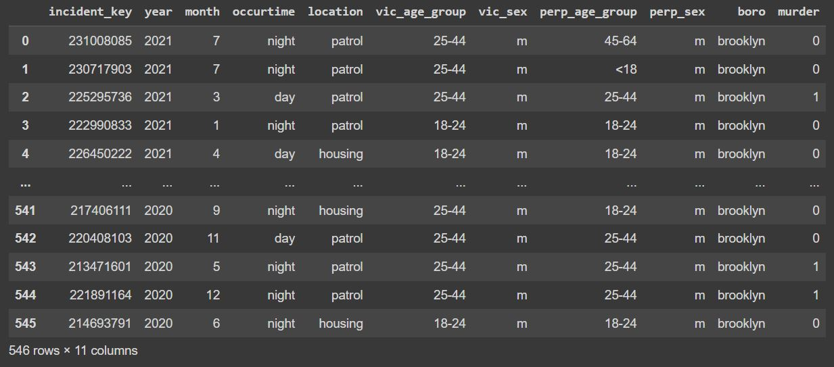
Cleaned Data To Database
conn = sqlite3.connect('CIS9650_Group8')
c = conn.cursor()
cleandf.to_sql('shooting', conn, if_exists='replace', index = False)
sql2df = sqla.create_engine('sqlite:///CIS9650_Group8')
pd.read_sql('SELECT * FROM shooting WHERE year between 2020 and 2021 AND boro = "brooklyn"', sql2df)

Slide 26
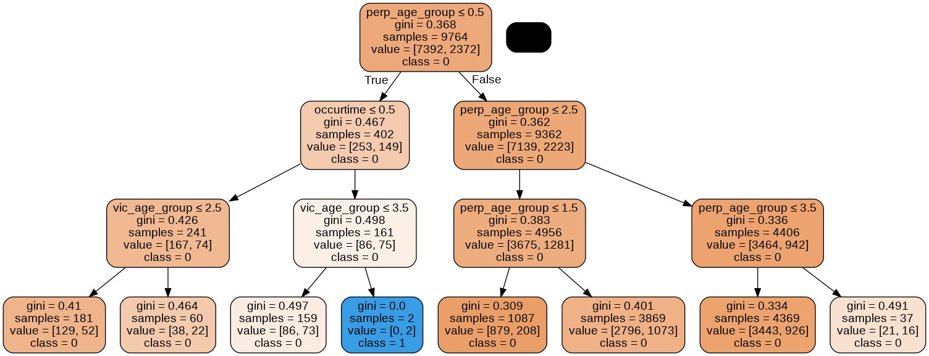
Use of the cleaned Data
The data can be used for reference or machine learning.
Here we decision tree to predict murder based on columns ['occurtime', 'location', 'vic_age_group', 'vic_sex', 'perp_age_group', 'perp_sex'].
Accuracy is 0.78 when using the model for test data set.

Slide 27
Thanks you for your time

